Slide 1



























INT104 – Database Management System Unit – III

Slide 2


Two-Phase Locking Techniques
Types of Locks and System Lock Tables
Shared/Exclusive (or Read/Write) Locks.
Conversion (Upgrading, Downgrading) of Locks.

Slide 3
Concurrency Control
To enforce Isolation (through mutual exclusion) among conflicting transactions.
To preserve database consistency through consistency preserving execution of transactions.
To resolve read-write and write-write conflicts.
Example:
In concurrent execution environment if T1 conflicts with T2 over a data item A, then the existing concurrency control decides if T1 or T2 should get the A and if the other transaction is rolled-back or waits.

Slide 4
Locking Techniques
A lock is a variable associated with a data item that describes the status of the item with respect to possible operations that can be applied to it.
There is one lock for each data item in the database.
Locks are used as a means of synchronizing the access by concurrent transactions to the database items.

Slide 5
Binary Locks
Binary locks – two states Lock / unlock
Mutual Exclusion
Critical section
Two operations, lock_item and unlock_item, are used with binary locking.
A transaction requests access to an item X by first issuing a
lock_item(X) operation.
When the transaction is through using the item, it issues an unlock_item(X) operation, which sets LOCK(X) back to 0 (unlocks the item) so that X may be accessed by other transactions.

Slide 6
Lock and unlock operations for binary
locks.
The following code performs the lock operation:
B: if LOCK (X) = 0 (*item is unlocked*) then LOCK (X) ← 1 (*lock the item*) else begin
wait (until lock (X) = 0) and the lock manager wakes up
the transaction);
goto B end;
The following code performs the unlock operation:
LOCK (X) ← 0 (*unlock the item*) if any transactions are waiting then
wake up one of the waiting the transactions;

Slide 7
Binary Locks
It is simple to implement a binary lock; all that is needed is a binary-valued variable.
Each lock can be a record with three fields:
<Data_item_name, LOCK, Locking_transaction>
plus a queue for transactions that are waiting to access the item.
The system needs to maintain only these records for the items that are currently locked in a lock table
Items not in the lock table are considered to be unlocked.
The DBMS has a lock manager subsystem to keep track of and control access to locks.

Slide 8
Binary Locks
If the simple binary locking scheme is used, every transaction must obey the following rules:
1. A transaction T must issue the operation lock_item(X) before any read_item(X) or write_item(X) operations are performed in T.
2. A transaction T must issue the operation unlock_item(X) after all read_item(X) and write_item(X) operations are completed in T.

Slide 9
Binary Locks
3.A transaction T will not issue a lock_item(X) operation if it already holds the lock on item X.
4. A transaction T will not issue an unlock_item(X) operation unless it already holds the lock on item X.

Slide 10
Shared/exclusive or read/write locks
Read operations on the same item are not conflicting
Must have exclusive lock to write
Three locking operations
read_lock(X)
write_lock(X)
unlock(X)

Slide 11
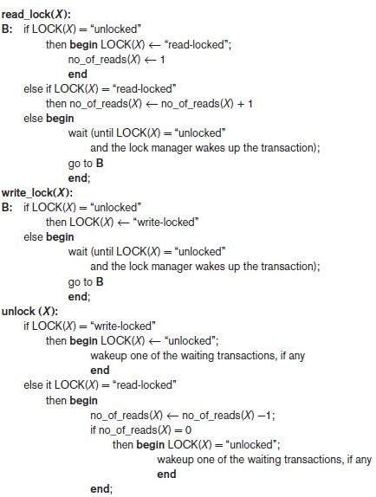
Locking and unlocking operations for two-mode (read/write, or shared/exclusive) locks
11

Slide 12
shared/exclusive locking scheme
When we use the shared/exclusive locking scheme, the system must enforce the following rules:
1. A transaction T must issue the operation read_lock(X) or write_lock(X) before any read_item(X) operation is performed in T.
2. A transaction T must issue the operation write_lock(X) before any write_item(X) operation is performed in T.
3. A transaction T must issue the operation unlock(X) after all read_item(X) and write_item(X) operations are completed in T.
12

Slide 13
shared/exclusive locking scheme
4. A transaction T will not issue a read_lock(X) operation if it already holds a read (shared) lock or a write (exclusive) lock on item X.
5. A transaction T will not issue a write_lock(X) operation if it already holds a read (shared) lock or write (exclusive) lock on item X.
6. A transaction T will not issue an unlock(X) operation unless it already holds a read (shared) lock or a write (exclusive) lock on item X.
13

Slide 14
Lock conversion
Transaction that already holds a lock allowed to convert the lock from one state to another
Upgrading
Issue a read_lock operation then a write_lock operation
Downgrading
Issue a read_lock operation after a write_lock operation

Slide 15

Two-Phase Locking Techniques
Types of Locks and System Lock Tables
Shared/Exclusive (or Read/Write) Locks.
Conversion (Upgrading, Downgrading) of Locks.
15

Slide 16

16

